Slide 1

Tidy Data II

Slide 2
Missing Values
Two Ways
Explicitly: Defined to Be Missing Using NA
Implicitly: Absent From Data
There is not a Uniform Way to Handle Either of These Problems
Rule: Either Convert All Explicitly Missing to Implicitly Missing or Convert All Implicitly Missing to Explicitly Missing

Slide 3
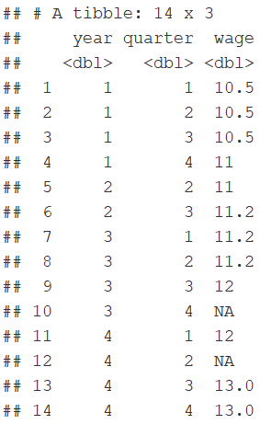
Missing Example

Slide 4
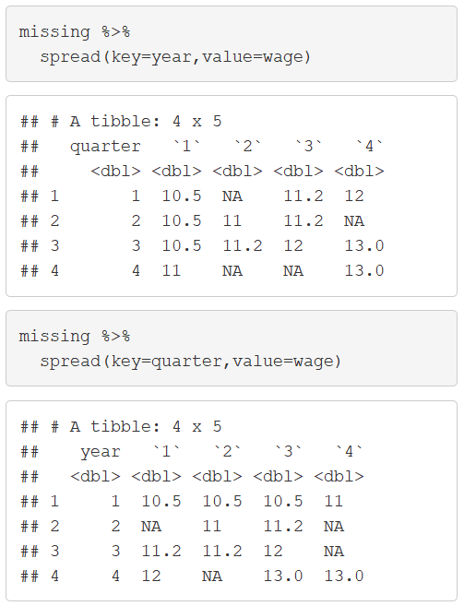
Missing Values
Notice:

Slide 5
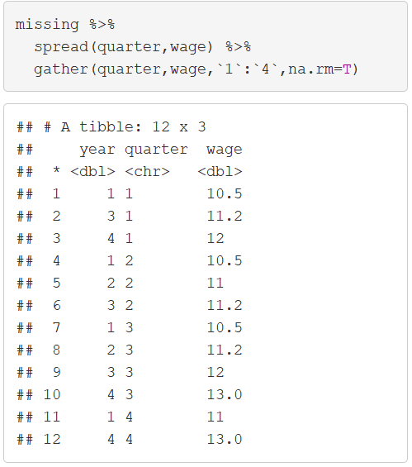
Missing Values
Explicit to Implicit

Slide 6
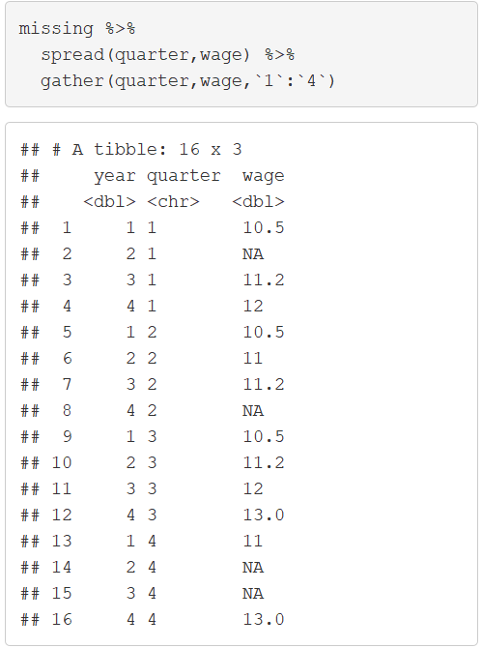
Missing Values
Implicit to Explicit

Slide 7
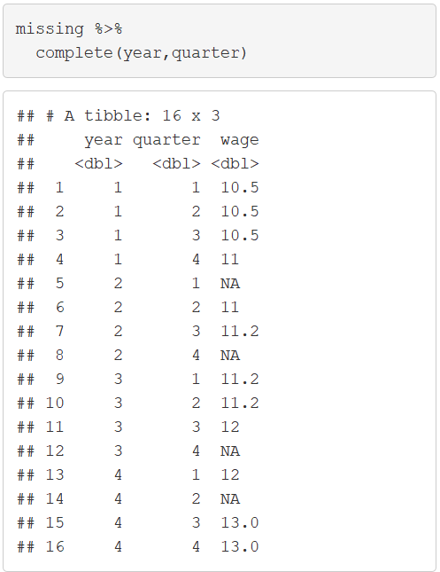
Missing Values
Complete Function

Slide 8
Closing
Disperse and Make Reasonable Decisions

